Slide 1
PHP Part II
Chapter 19: PHP part 2
By: Dr. Qusai Abuein

Slide 2
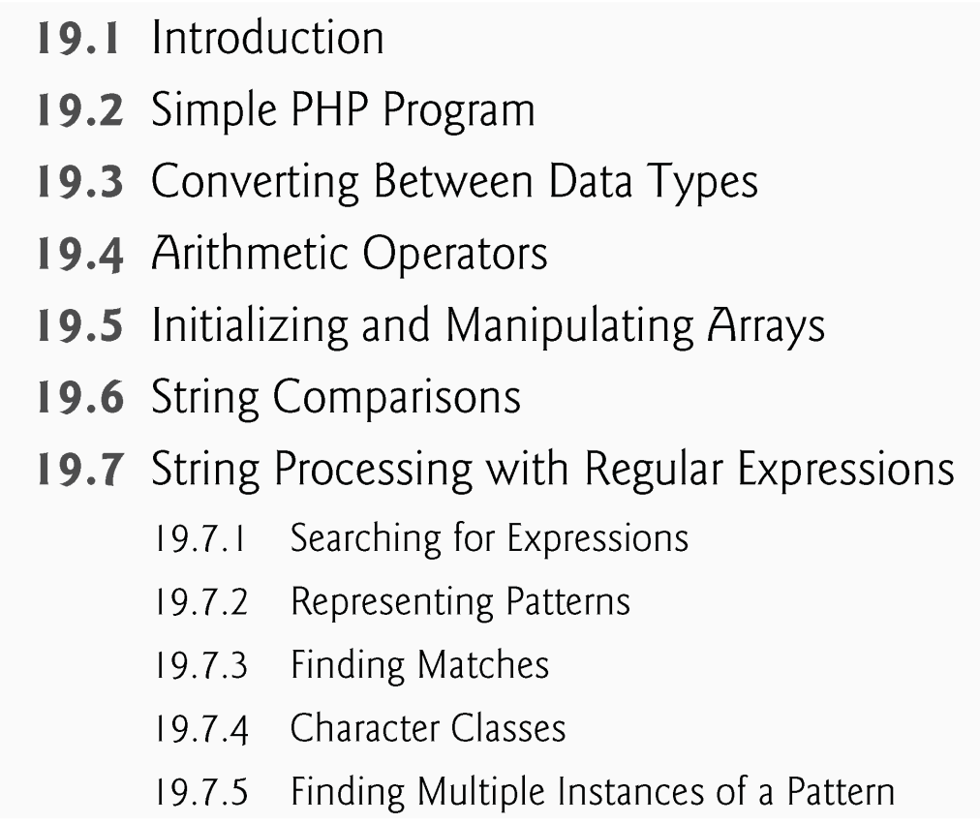
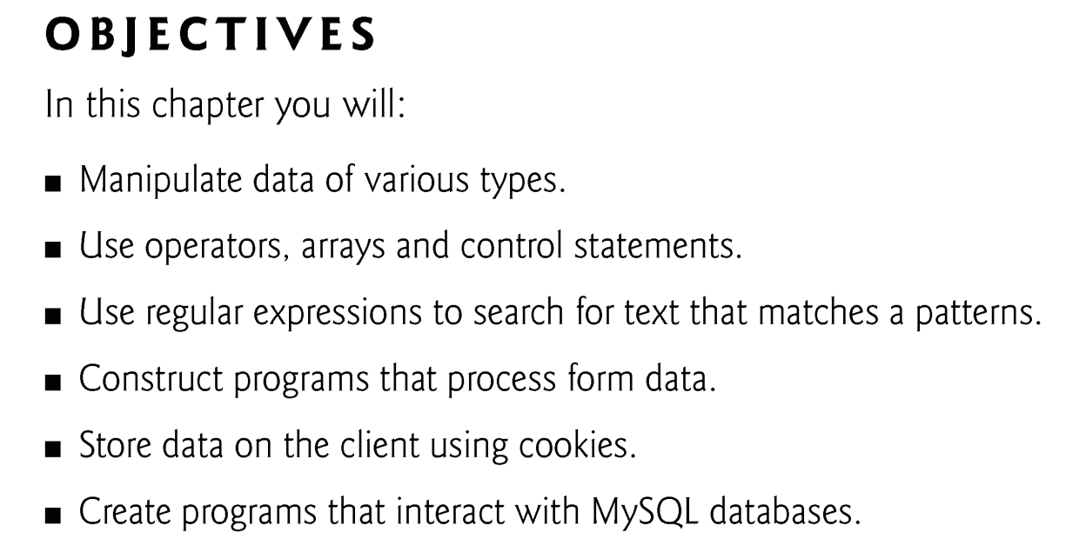
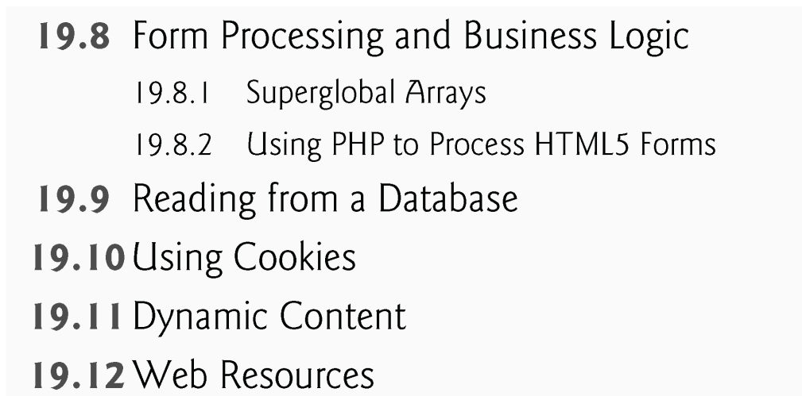

Slide 3
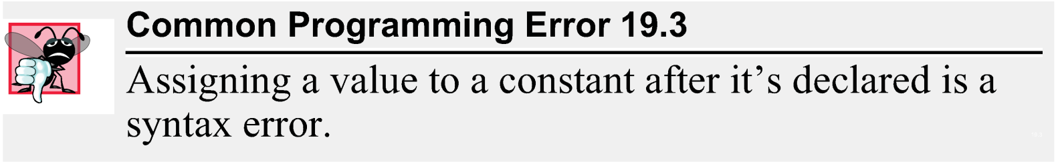
19.4 Arithmetic Operators
Function define creates a named constant. It takes two arguments—the name and value of the constant. An optional third argument accepts a boolean value that specifies whether the constant is case insensitive—constants are case sensitive by default.
Uninitialized variables have undefined values that evaluate differently, depending on the context. In a numeric context, it evaluates to 0. In contrast, when an undefined value is interpreted in a string context (e.g., $nothing), it evaluates to the string "undef".
Keywords may not be used as function, method, class or namespace names.

Slide 4
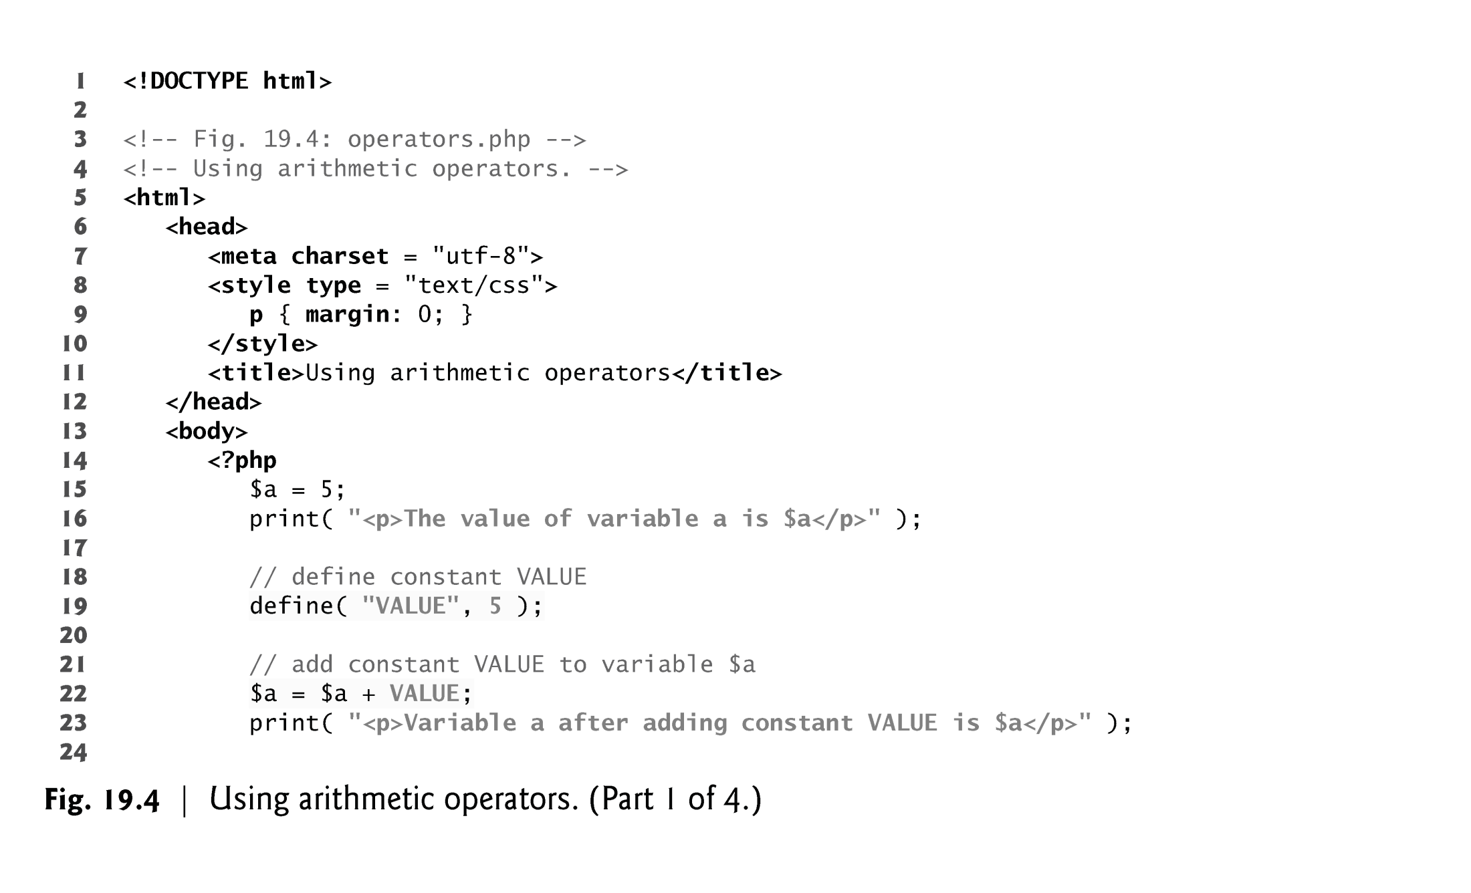
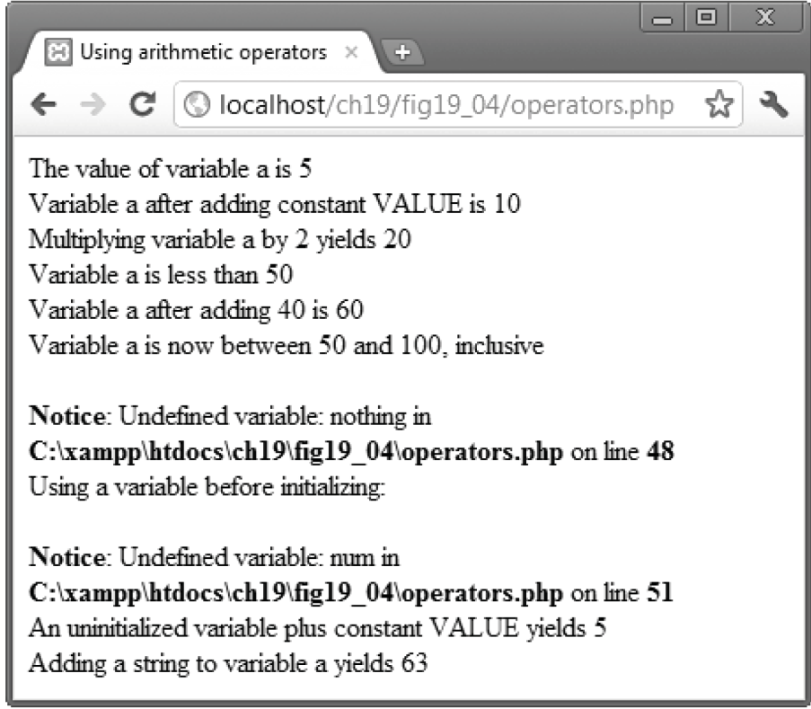

Slide 5
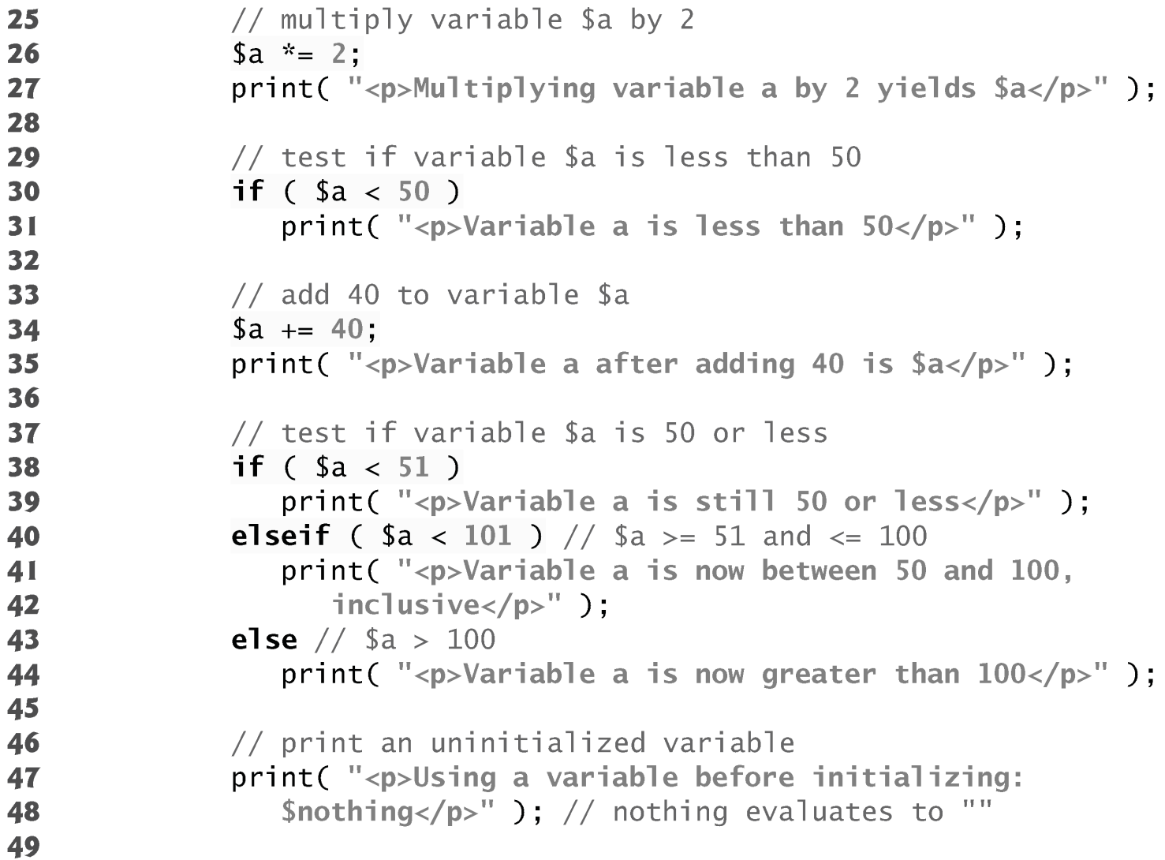
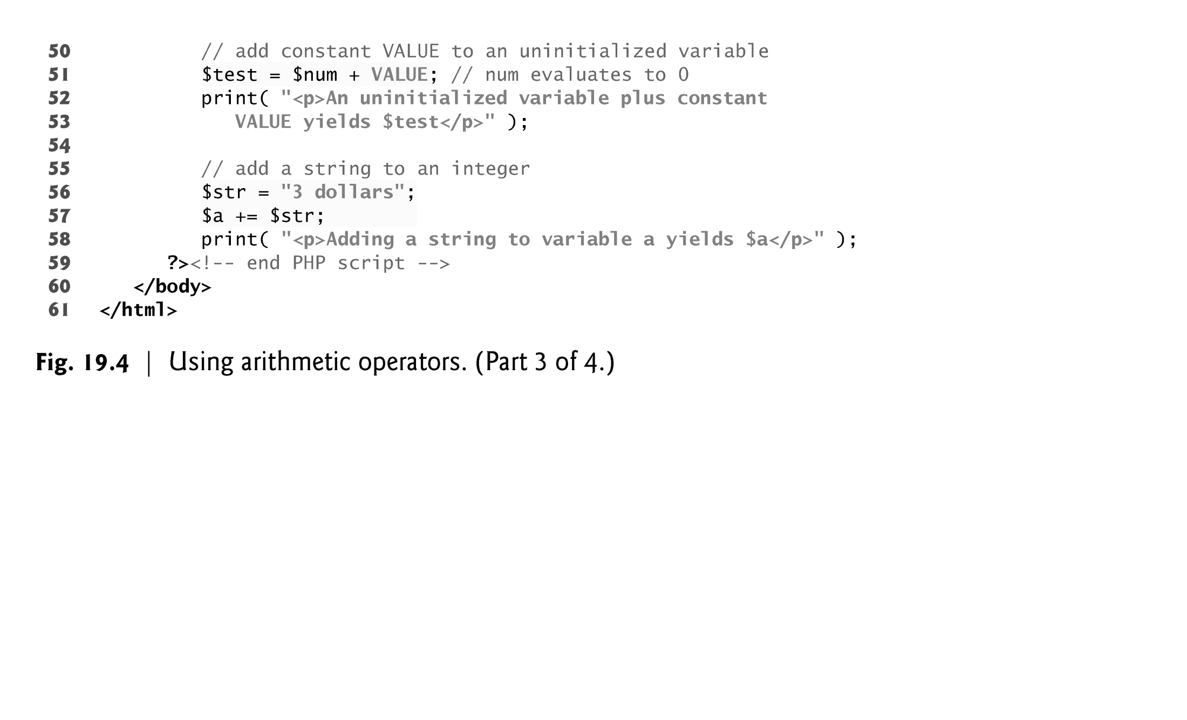

Slide 6
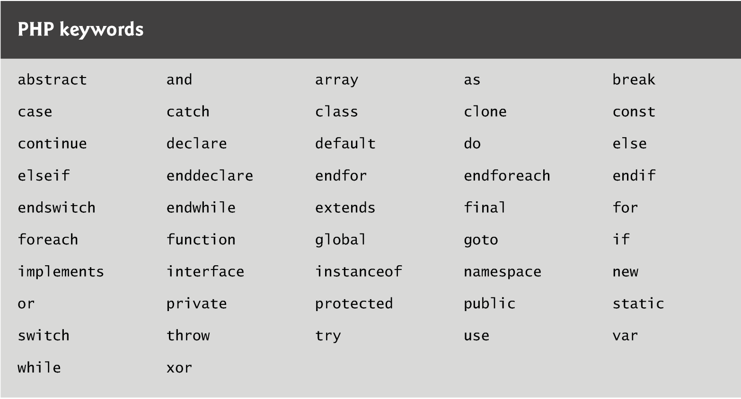

Slide 7
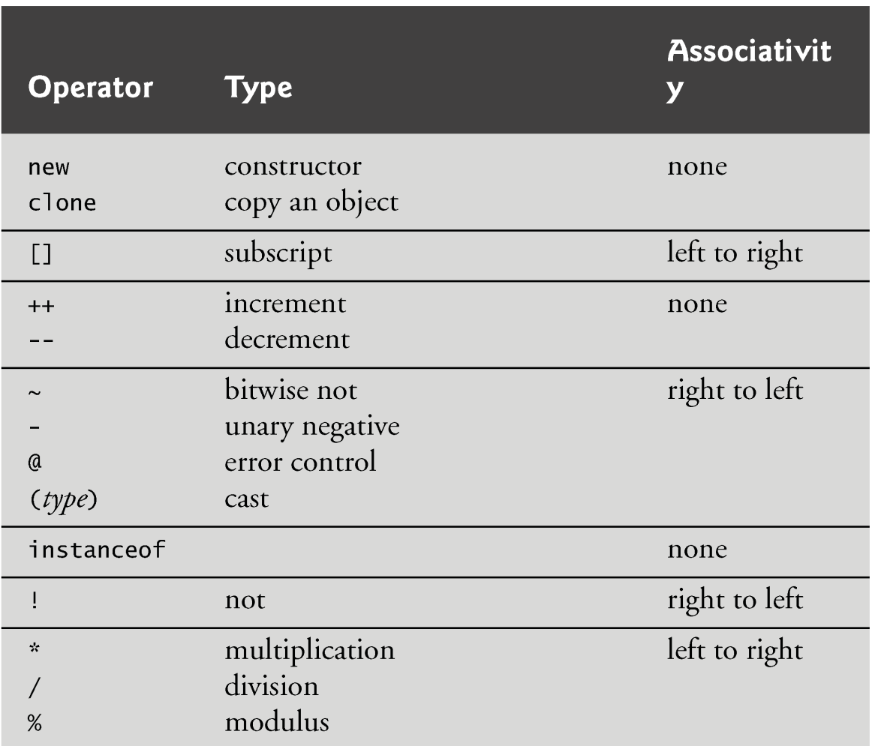
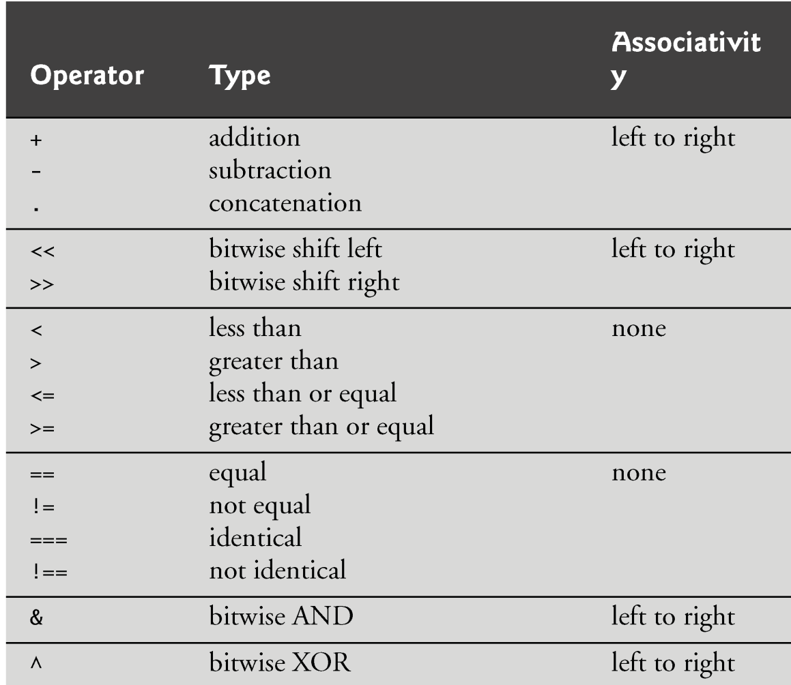
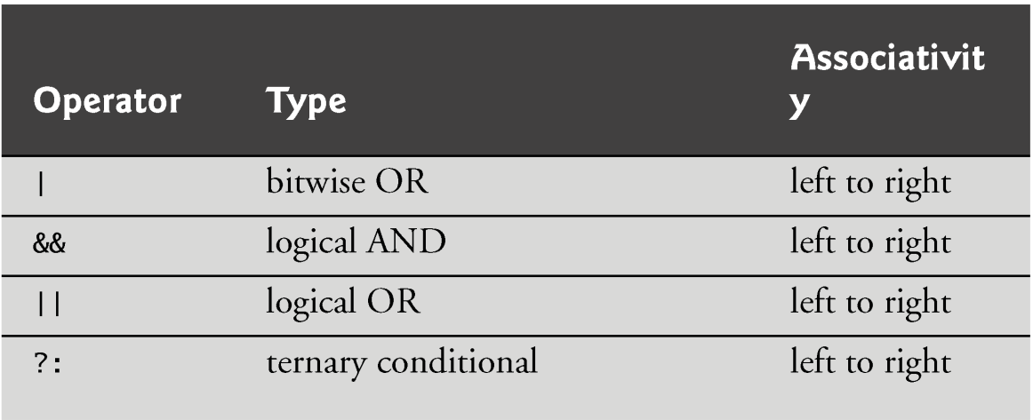

Slide 8
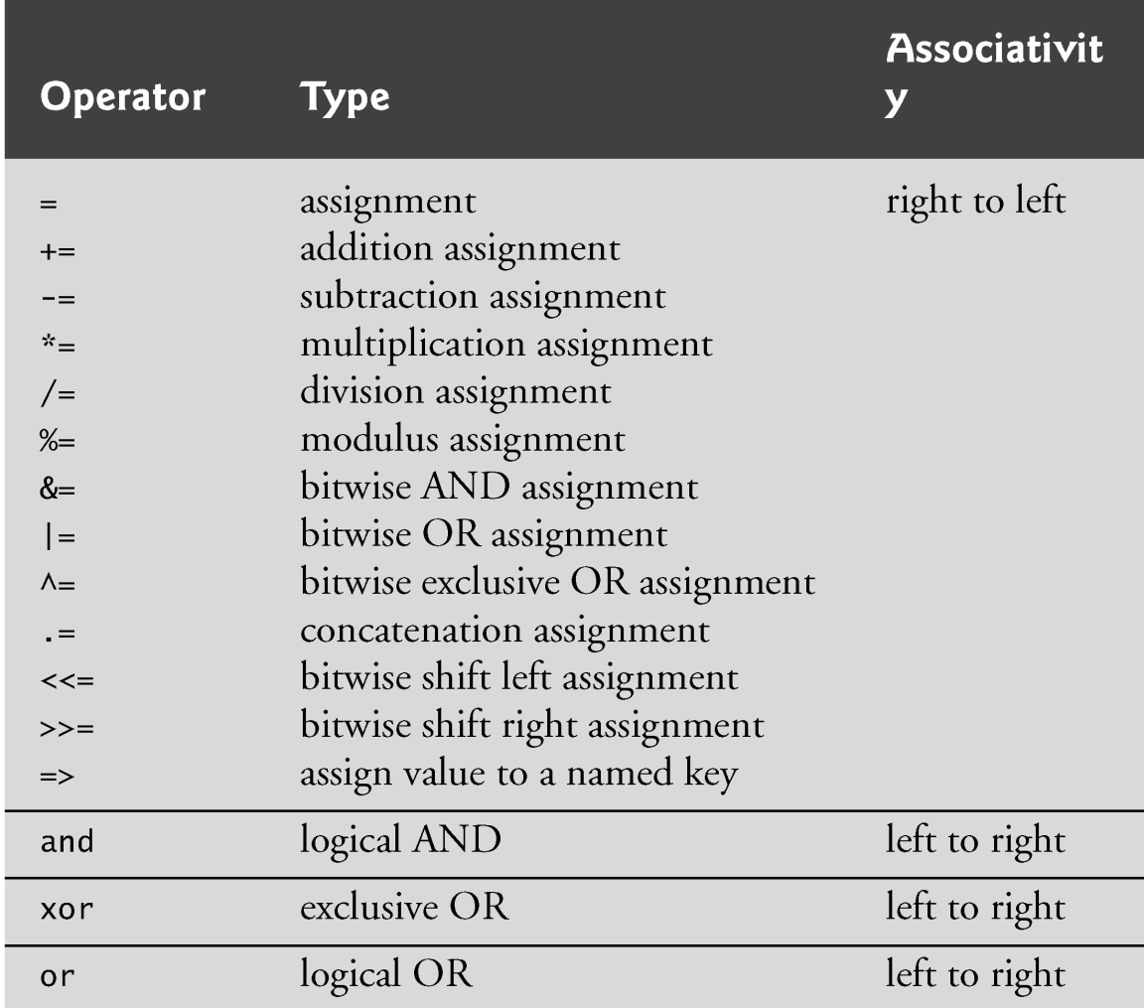

Slide 9
19.5 Initializing and Manipulating Arrays
PHP provides the capability to store data in arrays. Arrays are divided into elements that behave as individual variables. Array names, like other variables, begin with the $ symbol.
Individual array elements are accessed by following the array’s variable name with an index enclosed in square brackets ([]).

Slide 10
19.5 Initializing and Manipulating Arrays
If a value is assigned to an array element of an array that does not exist, then the array is created. Likewise, assigning a value to an element where the index is omitted appends a new element to the end of the array.
Function count returns the total number of elements in the array.
Function array creates an array that contains the arguments passed to it. The first item in the argument list is stored as the first array element (index 0), the second item is stored as the second array element and so on.

Slide 11
Array definition
Element By Element
$A[0] = 3; $A[1]=7; $A[]=5;
Array function
$B = array (3,7,5);
$C = array(“blue” , “red”);
to iterate through array elements
for($i =0 ; $i < count ($A) ; $i++)
print (“index $i has value $A[$i]”);

Slide 12
19.5 associative arrays
Arrays with nonnumeric indices are called associative arrays.
You can create an associative array using the operator =>, where the value to the left of the operator is the array index and the value to the right is the element’s value.

Slide 13
19.5 associative arrays
PHP provides functions for iterating through the elements of an array.
Each array has a built-in internal pointer, which points to the array element currently being referenced.
Function reset sets the internal pointer to the first array element. Function key returns the index of the element currently referenced by the internal pointer, and function next moves the internal pointer to the next element.
For (reset ($A) ; $i = key ($A) ; next ($A))

Slide 14
19.5 Initializing and Manipulating Arrays (Cont.)
The foreach statement, designed for iterating through arrays, starts with the array to iterate through, followed by the keyword as, followed by two variables—the first is assigned the index of the element and the second is assigned the value of that index’s element. (If only one variable is listed after as, it is assigned the value of the array element.)
Foreach ($A as $index => $value)
print (“index is $index has value $value”);

Slide 15
Outline
arrays.php
(1 of 4)
Automatically creates array $first
Sets the first element of array $first to the string “zero”
“three” is appended to the end of array $first
Returns the number of elements in the array

Slide 16
Outline
arrays.php
(2 of 4)
Function array creates array $second with its arguments as elements
Creates associative array $third
Sets the internal pointer to the first array element in $third
Returns the index of the element being pointed to
Moves the internal pointer to the next element and returns it

Slide 17
Outline
arrays.php
(3 of 4)
Uses operator => to initialize the element with index “January” to have value “first”
Iterates through each element in array $fourth
Stores the index of the element
Stores the value of the element

